Slide 1
NCTU DL Lab3-Conditional sequence-to-sequence VAE
TA 李仕柏
July 23, 2019

Slide 2
Outline
Lab Objective
Important Date
Lab Description
Hints
Scoring Criteria
Notes:
This course is a graduate-level course, which was first offered in spring term of 2017.
It is instructed by two other professors and me.
Back then, about 55 students were enrolled in this course.
In fact, we had a lot more students hoping to take it.
But, we could accept only 60 of them due to limited GPUs we have.
This course was concluded with a workshop in July this summer, with 26 teams presenting their final projects.
In this workshop, we also invited few experts from the industry to grade the students’ performance.
Some of them were amazed by the diversity of the students’ projects.

Slide 3
Lab Objective
In this lab, you need to implement a conditional seq2seq VAE for English tense conversion.
Tense conversion (4 tenses)
E.g. ‘access’ to ‘accessing’, or ‘accessed’ to ‘accesses’
Generative model
Gaussian noise + tense -> access, accesses, accessing, accessed

Slide 4
Important Date
Experiment Report Submission Deadline: 8/13 (Tue) 11:59 a.m
Demo date: 8/13 (Tue.)
Zip all files in one file
Report (.pdf)
Source code
name it like「DLP_LAB3_yourstudentID_name.zip」
ex: 「DLP_LAB3_0756051_李仕柏.zip」
-5% to your report if you do not follow the rule
Take 10 % of your assignment score (other 5 take 6%, total is 40%)

Slide 5
Lab Description
To understand sequence-to-sequence architecture
Embedding function
Teacher forcing technique
Word dropout
To understand CVAE
Reparameterization trick
Log variance
KL lost annealing
Condition

Slide 6
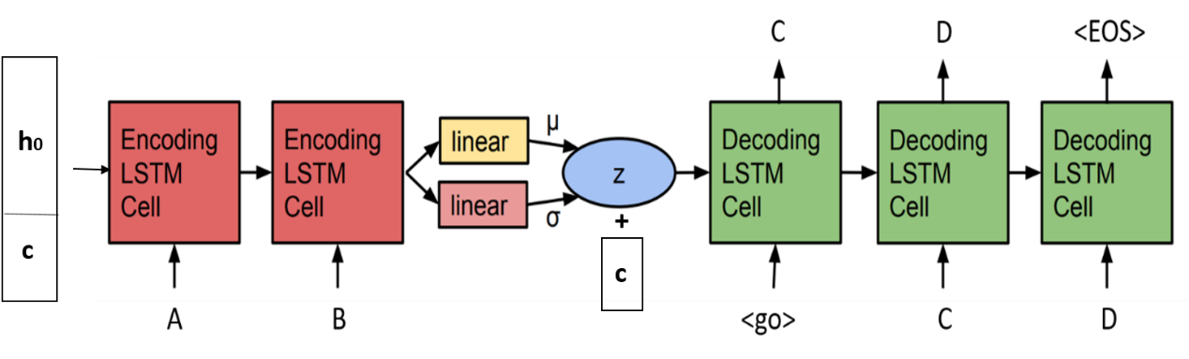
Lab Description - architecture
Input word: ‘access’
Initial input of encoder : (h_0+‘simple present’,’a’)
Initial input of decoder : (z+’present progressive’,’<go>’)

Slide 7
Lab Description – seq2seq
Embedding function (for characters and conditions)
[1,2,3] -> [shape(128), shape(128), shape(128)] (high dimensional space)
Teacher forcing
Using ground truth character instead of the output of the decoder.
Word dropout (optional)
Change the input of the decoder to <UNK> token.

Slide 8
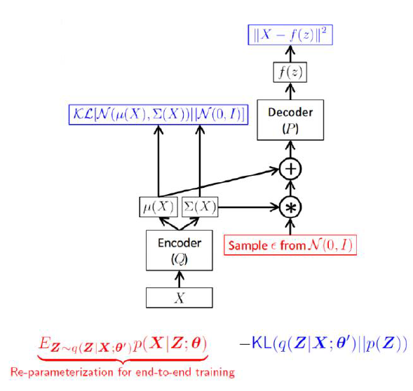
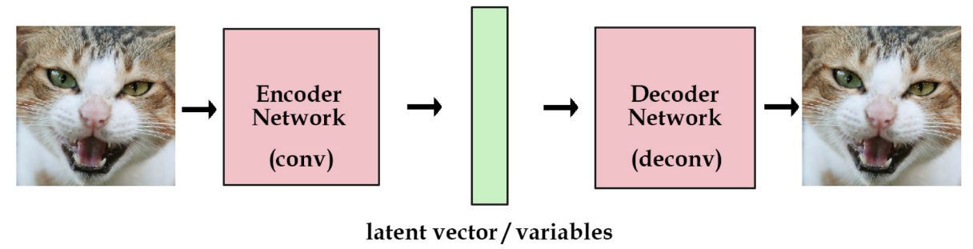
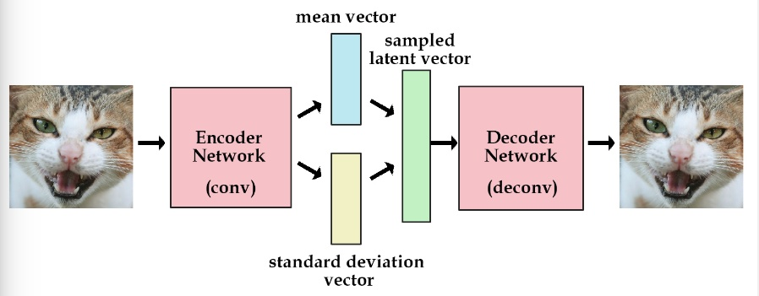
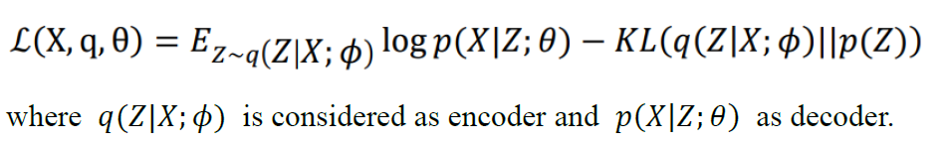
Lab Description - VAE
VAE objective: reconstruction and generation

Slide 9
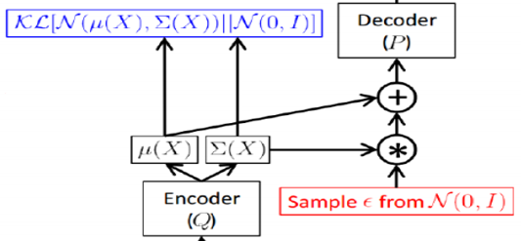
Lab Description - CVAE
Reparameterization trick
Log variance
Output should be log variance (not variance)
Condition
Simply concatenate to the hidden_0 and z
Embed your condition to high dimensional space (or simply use one-hot)

Slide 10
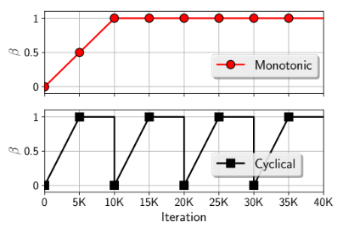
Lab Description - CVAE
KL cost annealing
Initially set your KL weight to 0
Maximum value is 1

Slide 11
Lab Description – Other details
The encoder and decoder are implemented by LSTM.
The loss function is nn.CrossEntropyLoss().
The optimizer is SGD
Adopt BLEU-4 score function in NLTK.
Average 10 testing socres
Adopt Gaussian_score() to compute the generation score
Random sample 100 noise to generate 100 words with 4 different tenses (400)
4 words should exactly match the training data.

Slide 12
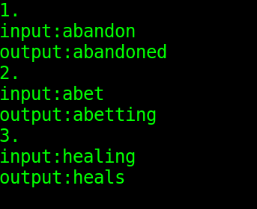
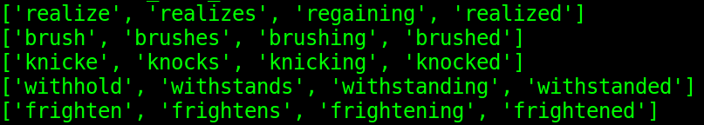
Lab Description – Requirements
Modify encoder, decoder, and training functions
Implement evaluation function, dataloader, and reparameterization trick.
Adopt teacher-forcing and kl loss annealing in your training processing.
Plot the crossentropy loss, KL loss, and BLEU-4 score curve during training.
Output examples (tense conversion & Gaussian noise with 4 tenses)

Slide 13
Hints
Training method
Input the word with the tense and the output should also be the same word.
Convert each character to a number (dictionary)
Model weights
Strongly recommend you save your model weights during training
Teacher forcing ratio and KL weight
Influential to the performance of model
You can first set your KL weight to 0 to see whether your model works.

Slide 14
Scoring Criteria
Report (50%)
Introduction(5%)
Implementation details(15%)
Describe how you implement your model. (e.g. dataloader, encoder, decoder, etc)
Specify the hyperparameters (KL weight, teacher forcing ratio, etc.)
Notice: You must prove that your text generation is produced by Gaussian noise (paste/screenshot your code)
Results and discussion(30%)
Plot the loss and KL loss curve while training and discuss the results.
Plot the BLEU-4 score of your testing data while training and discuss the result.
Notice: This part mainly focuses on your discussion, if you simply just paste your results, you will get a low score

Slide 15
Scoring Criteria
Demo(50%)
Capability of tense conversion on testing data. (10%)
score >= 0.7 ---- 100%
0.7 > score >= 0.6 ---- 90%
0.6 > score >= 0.4 ---- 80%
score < 0.4 ---- 0%
Capability of word generation. (Gaussian noise + tense) (20%)
score = Gaussian_score() (100 words with 4 tenses)
score >= 0.3 ---- 100%
0.3 > score >= 0.2 ---- 90%
0.2 > score >= 0.05 ---- 80%
Otherwise ---- 0%
Questions (20%)

